Slide 1

Song Recommendation System Using Facial Recognition
Submitted in the partial fulfillment for the award of the degree of
BACHELOR OF ENGINEERING
IN
Artificial Intelligence and Machine Learning
Submitted by:
Akshat Pareta (20BCS6567)
Ribhav Sharma (20BCS6558)
Rohan Mishra (20BCS4456)
Simranjeet Singh (20BCS6575)
Under the Supervision of:
Mr. Himanshu Mishra
Department of AIT-CSE
DISCOVER . LEARN . EMPOWER

Slide 2

Contents
Music to the Soul
Introduction to the Project
Problem Formulation
Methodology
Face Recognition
Speech Recognition
Results and Outputs
Conclusion
Future Scope and Prospects
Reference Links

Slide 3


Music To The Soul
Our brain responds to each external stimulus instantly, and the sound of the music is one of them.
Music stimulates the part of the brain that produces the dopamine hormone. This hormone affects emotional behavior and mood.
The influence of music is both behavioral and neural.
That is, this means that music not only affects the mood but also affects what we cannot control ourselves.

Slide 4

Introduction to the Project
By the help of numerous machine learning algorithms and concepts, we detect the face of the user to recognize the mood.
Once, we have that data, we play random songs that fit the mood.
We’ve added a voice recognition feature where user can just speak out his or her mood.
Finally, we added a personal touch by including a threaded virtual assistant to give a real life experience.

Slide 5

Problem Formulation
One of the main reasons for us to make this project was to cater to the behavioral and mood changes that one goes through.
By the help of numerous machine learning algorithms and concepts, we detect the face of the user to recognize the mood.
Once, we have that data, we play random songs that fit the mood. We’ve added a voice recognition feature where user can just speak out his or her mood.
Finally, we added a personal touch by including a threaded virtual assistant to give a real life.

Slide 6
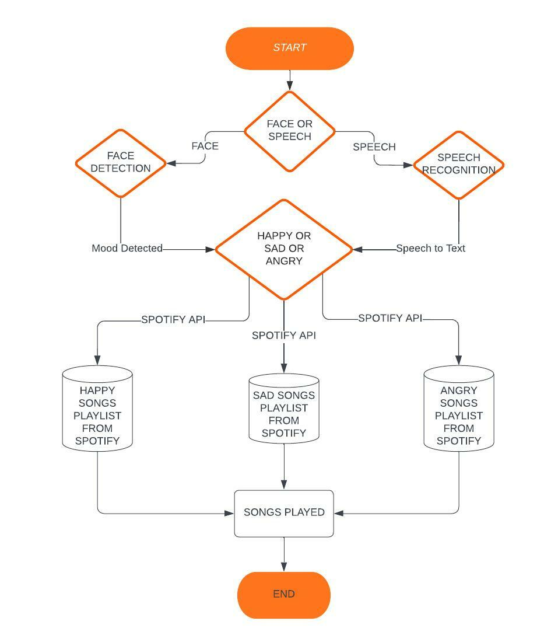
Methodology

Slide 7
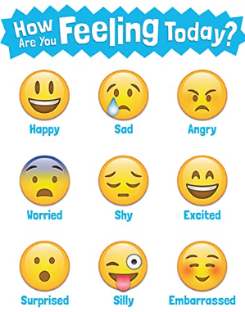
Emotion Detection
OPEN CV:
The library has more than 2500 optimized algorithms, which includes a comprehensive set of both classic and state-of-the-art computer vision and machine learning algorithms.
Extract 3D models of objects, produce 3D point clouds from stereo cameras, stitch images together to produce a high resolution image of an entire scene, find similar images from an image database
DEEPFACE:
Deepface is a lightweight face recognition and facial attribute analysis (age, gender, emotion and race) framework for python. It is a hybrid face recognition framework wrapping state-of-the-art models: VGG-Face, Google FaceNet, OpenFace etc.

Slide 8
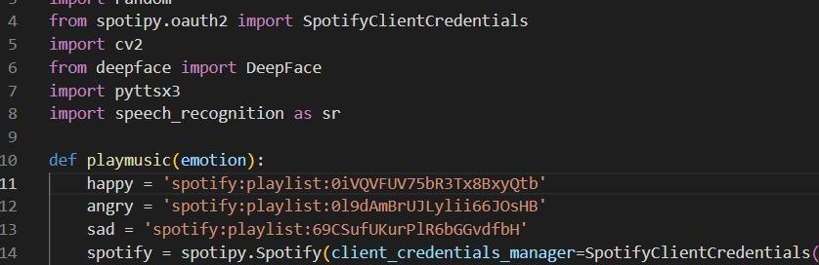
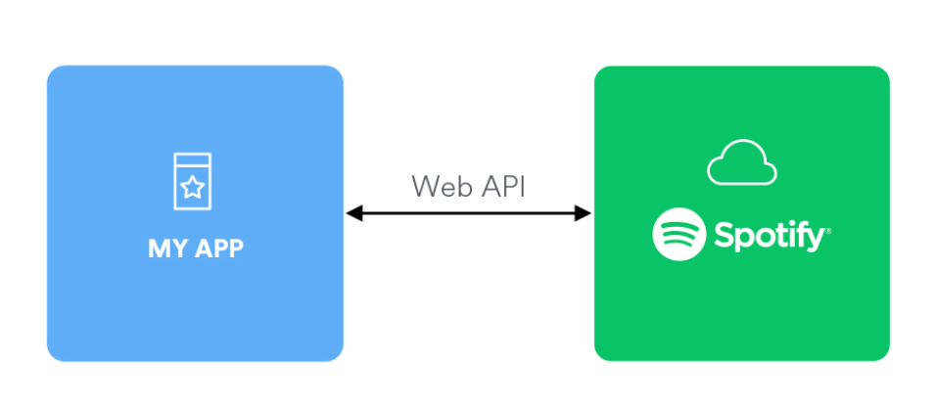
Spotify API
Spotify API
Web API also provides access to user related data, like playlists and music that the user saves in the Your Music library. Such access is enabled through selective authorization, by the user.
The base address of Web API is https://api.spotify.com. The API provides a set of endpoints, each with its own unique path. To access private data through the Web API, such as user profiles and playlists, an application must get the user’s permission to access the data. Authorization is via the Spotify Accounts service.

Slide 9
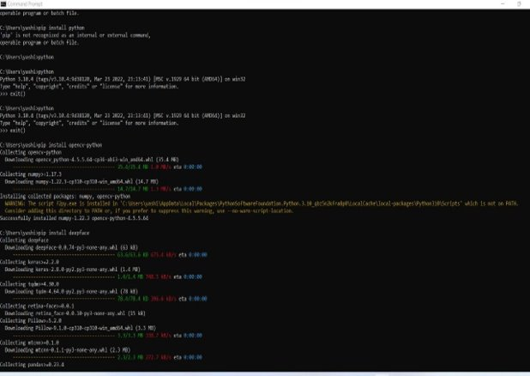
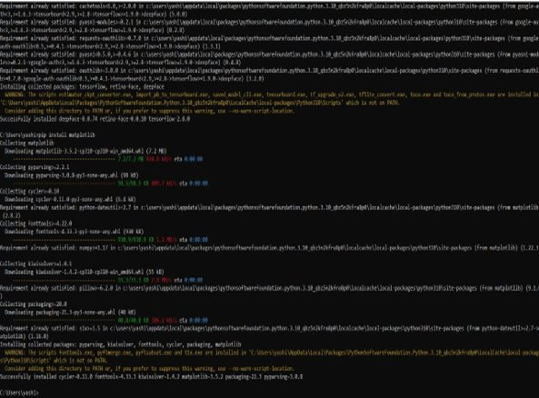
Results and Output
Installing Libraries in cmd prompt

Slide 10
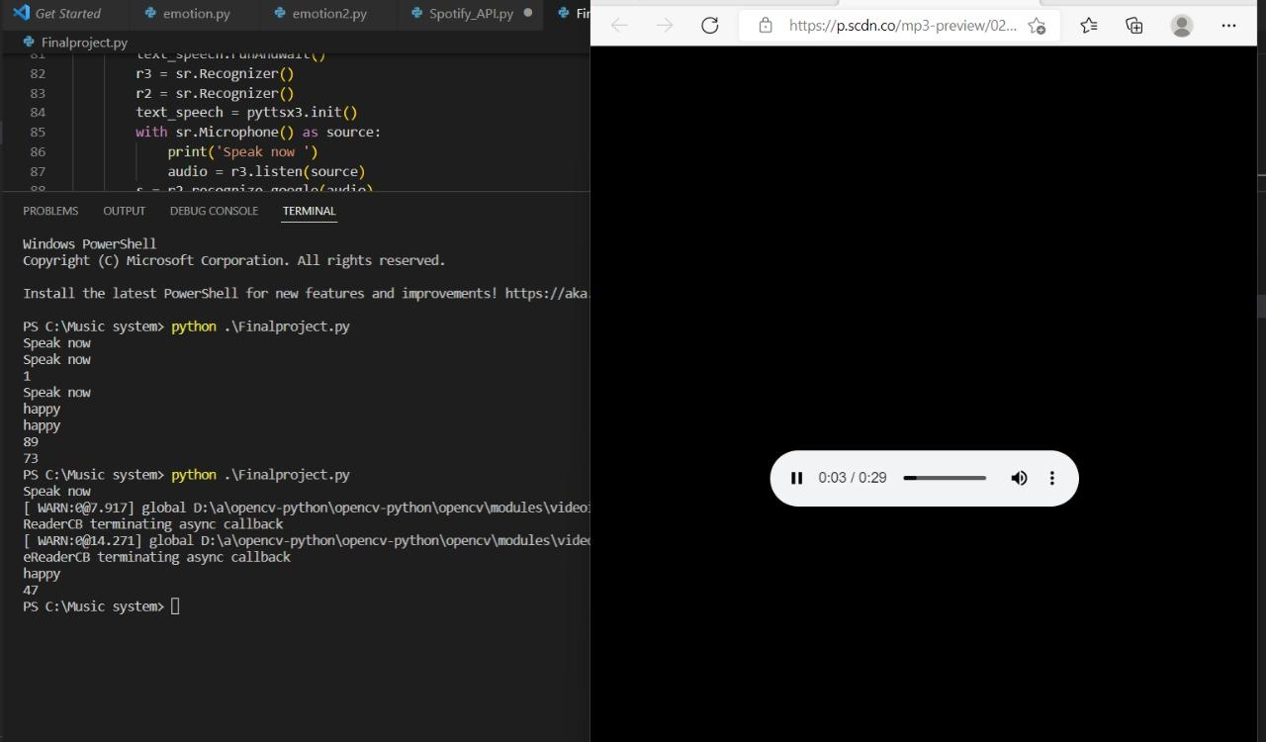
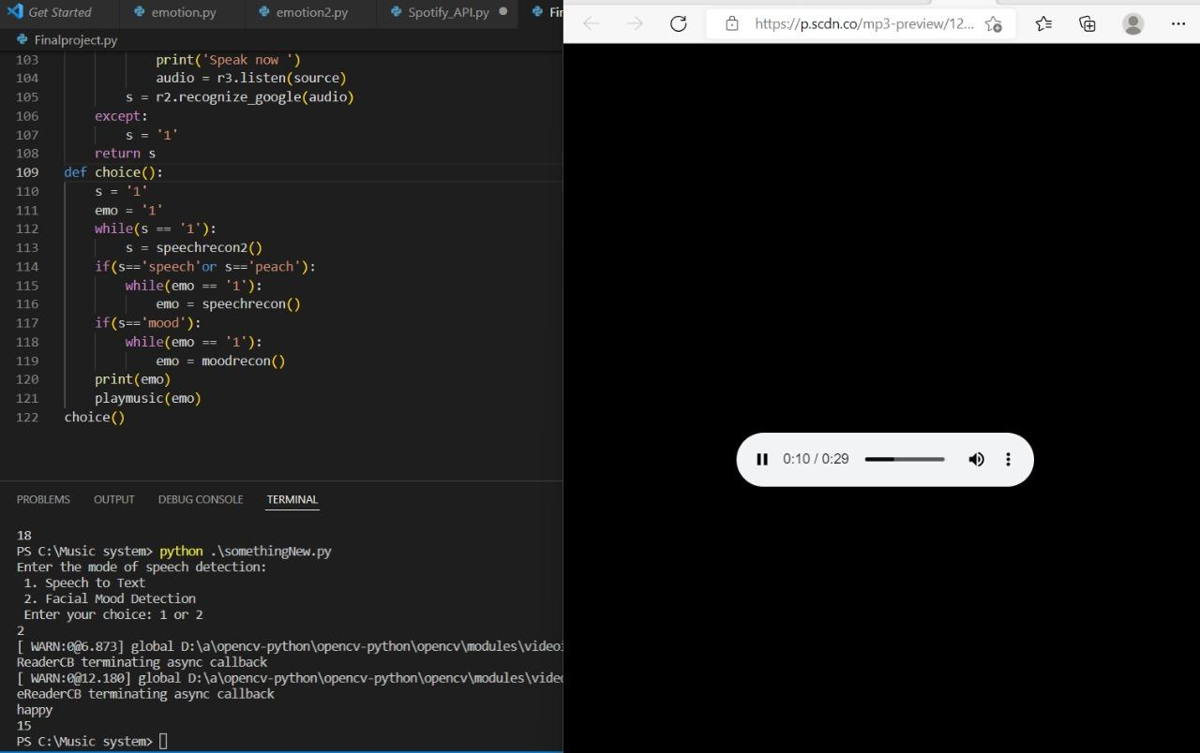
Results and Output
Mood being detected and music being played
Happy Songs

Slide 11
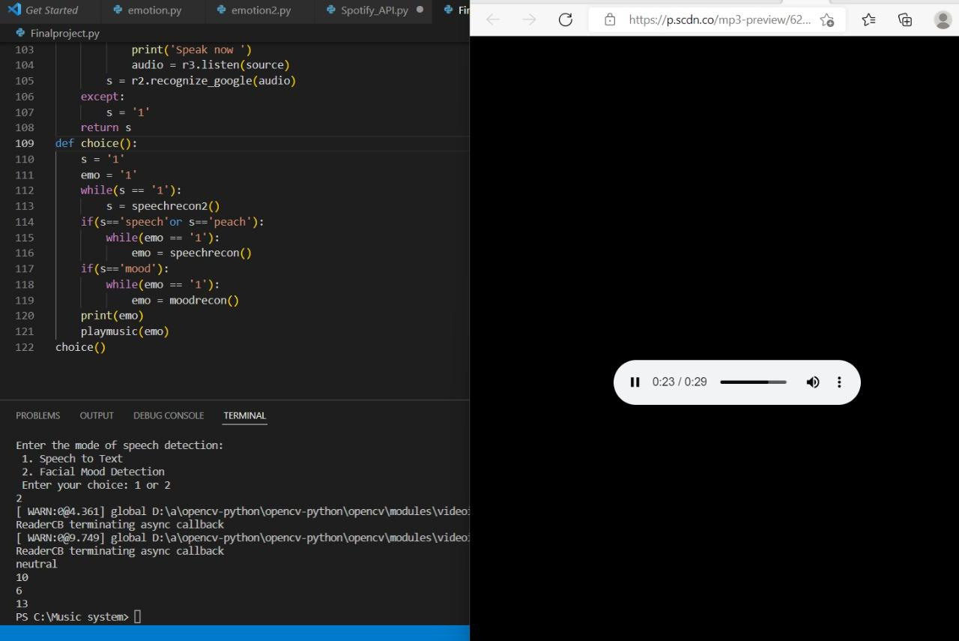
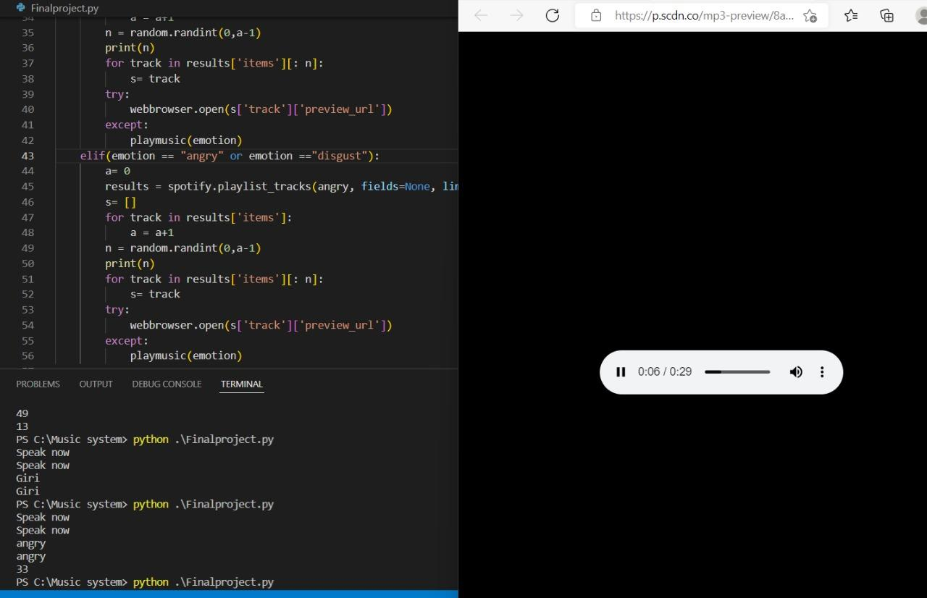
Results and Output
Mood being detected and music being played
Sad and Angry Songs

Slide 12

Conclusion
Using the knowledge gained and the research done for this project, we were able to create a real time product type project that we are proud of.
We learned about a lot of new things and came across a lot of new ideas and under the guidance of our teacher and other mentors, we were able to accomplish

Slide 13
Future Scope and prospect :
If we want to improve your recognition accuracy, Increase the size of the dataset by applying more (random) transformations to the input images.
I intend to expand this research to a larger scale in the future so that different embedding models can be considered on a wider range of datasets.
This system will be used to detect more types of facial emotions .
To create an android application based on this Deep learning model.
Develop a fully working website for Facial Emotion Detection.
To improve prediction accuracy and get accurate results for the complex emotions.
To reduce the character error rate by training the model with more datasets and samples.
In the future, we can look to directly play songs from Spotify or any other music playing app according to the user's discretion.
We can also try to dynamically detect our mood and satisfy and the user with more than one components like videos and favorite photos along with a fitting theme music.

Slide 14
References
https://dolby.io/blog/capturing-high-quality-audio-with-python-and-pyaudio/#:~:text=PyAudio%20is%20a%20set%20of,library%20interfacing%20with%20audio%20drivers.
https://riptutorial.com/python/topic/10627/pyaudio#:~:text=Introduction%23,on%20a%20variety%20of%20platforms.
https://pypi.org/project/SpeechRecognition/
https://github.com/serengil/deepface
https://opencv.org/about/

Slide 15


